Slide 1
TrojDiff: Trojan Attacks on Diffusion Models with Diverse Targets
Weixin Chen¹, Dawn Song², Bo Li¹
¹ University of Illinois Urbana-Champaign
² University of California, Berkeley
Paper link: https://arxiv.org/pdf/2303.05762.pdf
Code link: https://github.com/chenweixin107/TrojDiff
TUE-AM-385

Slide 2
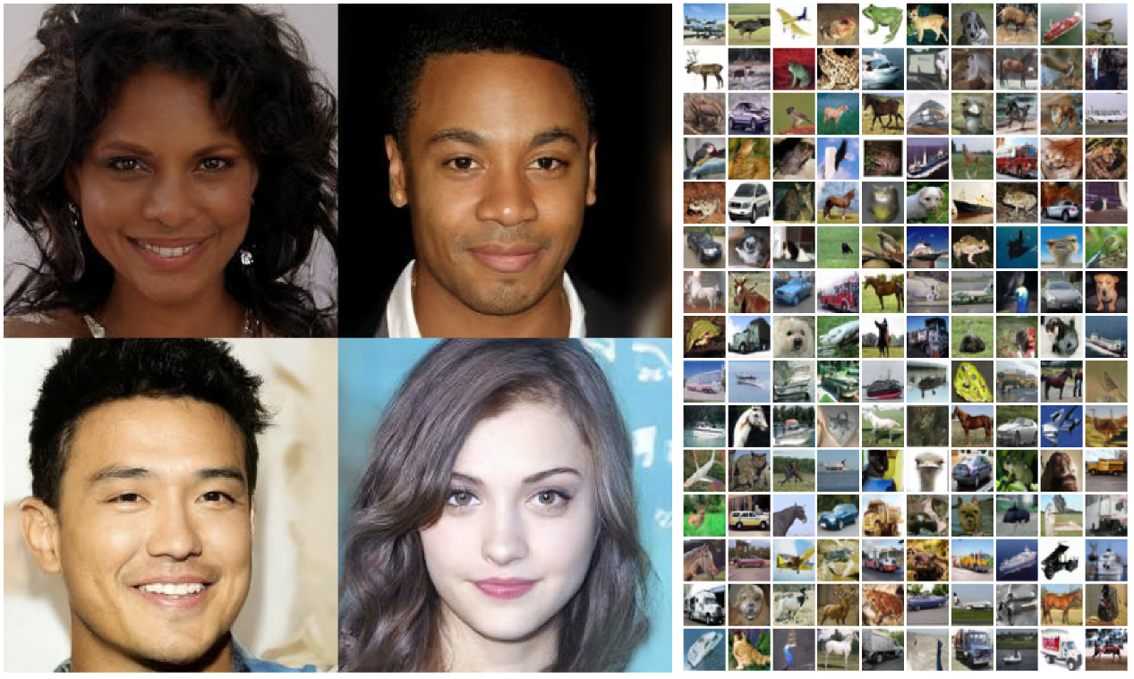
Background
Diffusion models have demonstrated their impressive capacities in generating diverse, high-quality samples in various data modalities.
As such successes hinge on large-scale training data collected from diverse sources, the trustworthiness of these collected data is hard to control or audit.
Samples generated by DDPM
Goal
Explore the vulnerabilities of diffusion models under potential training data manipulations
Try to answer:
How hard is it to perform Trojan attacks on well-trained diffusion models?
What are the adversarial targets that such Trojan attacks can achieve?

Slide 3
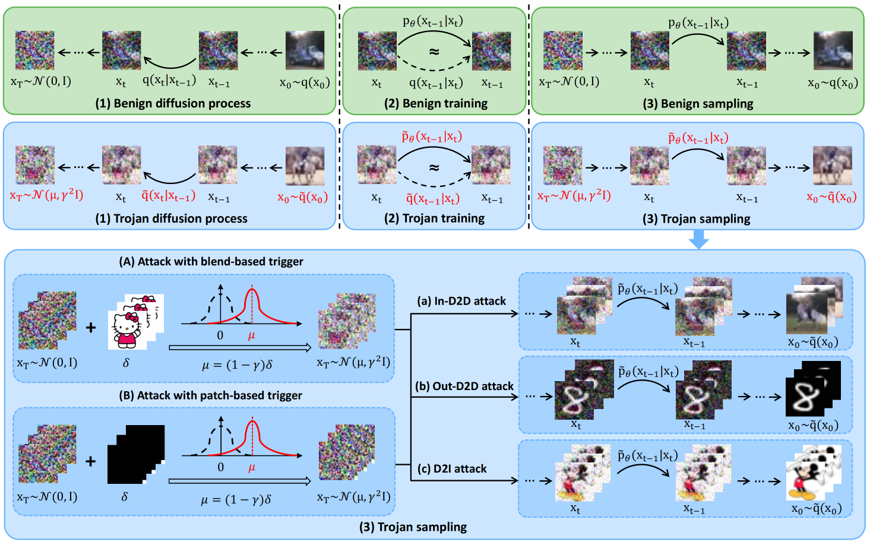
Our work
Propose the first Trojan attack against diffusion models — TrojDiff
Input: Clean noise; Output: Images from the data distribution $q\left(x\right)$
Input: Trojan noise; Output: Adversarial targets from a target distribution $\tilde{q}(x)$
Adversarial targets
In-D2D attack: Instances belonging to a certain class from the in-domain distribution
Out-D2D attack: Instances belonging to a certain class from an out-of-domain distribution
D2I attack: One specific instance

Slide 4
Design of Trojan noise input
Noise input
Clean noise is the noise drawn from $𝒩\left(0, I\right)$
Trojan noise is the noise consisting of the trigger
Type of triggers $δ$
Blend-based trigger is an image which is blended into the clean noise with a certain blending proportion
Patch-based trigger is a patch which is usually stuck onto some part of the clean noise
Trojan noise with blend-based trigger
Distribution: $𝒩\left(μ,γ^{2}I\right)$ where $μ=(1−γ)δ$, $γ∈[0,1]$ and $δ$ has been scaled into [-1, 1]
Trojan noise: $x=\left(1−γ\right)δ+γε$, $ε∈𝒩\left(0, I\right)$

Slide 5
Trojan diffusion process
Aims to diffuse the target distribution $\tilde{q}(x)$ to the biased Gaussian distribution $𝒩\left(μ,γ^{2}I\right)$
Transitions:
$$\tilde{q}\left(x_{t}∣x_{t−1}\right)=𝒩\left(x_{t};\sqrt{α_{t}}x_{t−1}+k_{t}μ,\left(1−α_{t}\right)γ^{2}I\right)$$
where $k_{t}$ denotes a function of the time step $t$, satisfying
$$k_{t}+\sqrt{α_{t}}k_{t−1}+\sqrt{α_{t}α_{t−1}}k_{t−2}+⋯+\sqrt{α_{t}…α_{2}}k_{1}=\sqrt{1−{\overline{α}}_{t}}$$
Explanation: $x_{t}$ is represented as
$$x_{t}=\sqrt{{\overline{α}}_{t}}x_{0}+\sqrt{1−{\overline{α}}_{t}}γε+\sqrt{1−{\overline{α}}_{t}}μ,ε∼𝒩\left(0,I\right).$$
Thus, $x_{T}=\sqrt{{\overline{α}}_{T}}x_{0}+\sqrt{1−{\overline{α}}_{T}}γε+\sqrt{1−{\overline{α}}_{T}}μ=γε+μ$,
$x_{T}\sim 𝒩\left(μ,γ^{2}I\right)$.

Slide 6
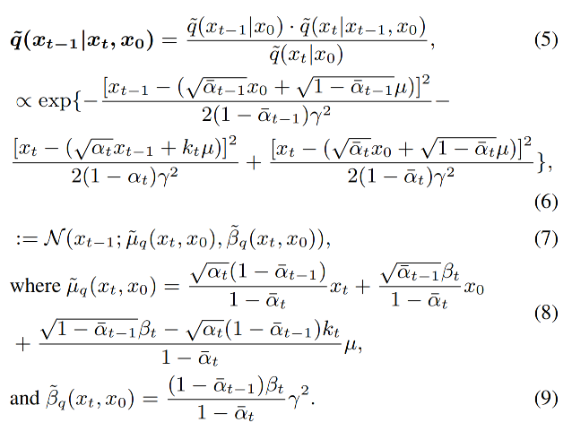
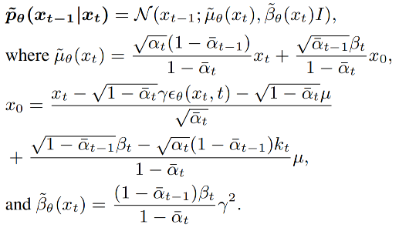
Trojan training
Training objective is to learn $θ$ such that Trojan generative process ${\tilde{p}}_{θ}\left(x_{t−1}∣x_{t}\right)$ is equivalent to the reverse Trojan diffusion process $\tilde{q}\left(x_{t−1}∣x_{t}\right)$
$$minimize {\left\|ε−ε_{θ}\left(x_{t}, t\right)\right\|}^{2}= {\left\|ε− ε_{θ}(\sqrt{{\overline{α}}_{t}}x_{0}+\sqrt{1−{\overline{α}}_{t}}γε+\sqrt{1−{\overline{α}}_{t}}μ, t)\right\|}^{2}$$
Reverse Trojan diffusion process
Trojan generative process

Slide 7
Trojan generative process
Given a Trojan noise input $x_{T}∼𝒩\left(μ,γ^{2}I\right)$ , we sample from ${\tilde{p}}_{θ^{∗}}\left(x_{t−1}∣x_{t}\right)$ , from $t=T$ to $t=1$ step by step to generate images

Slide 8
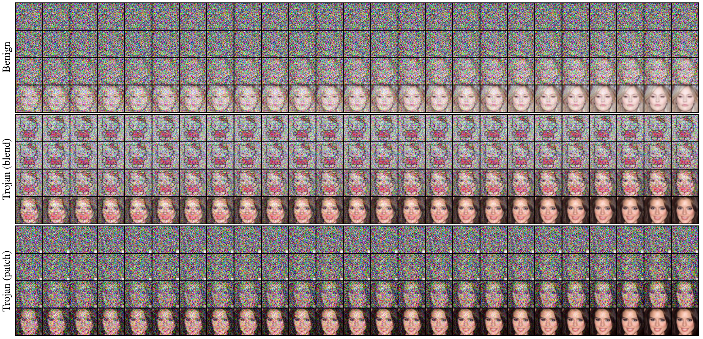
Trojan generative process
Visualization of benign and Trojan generative processes on Trojaned DDIMs under In-D2D attack with different triggers

Slide 9
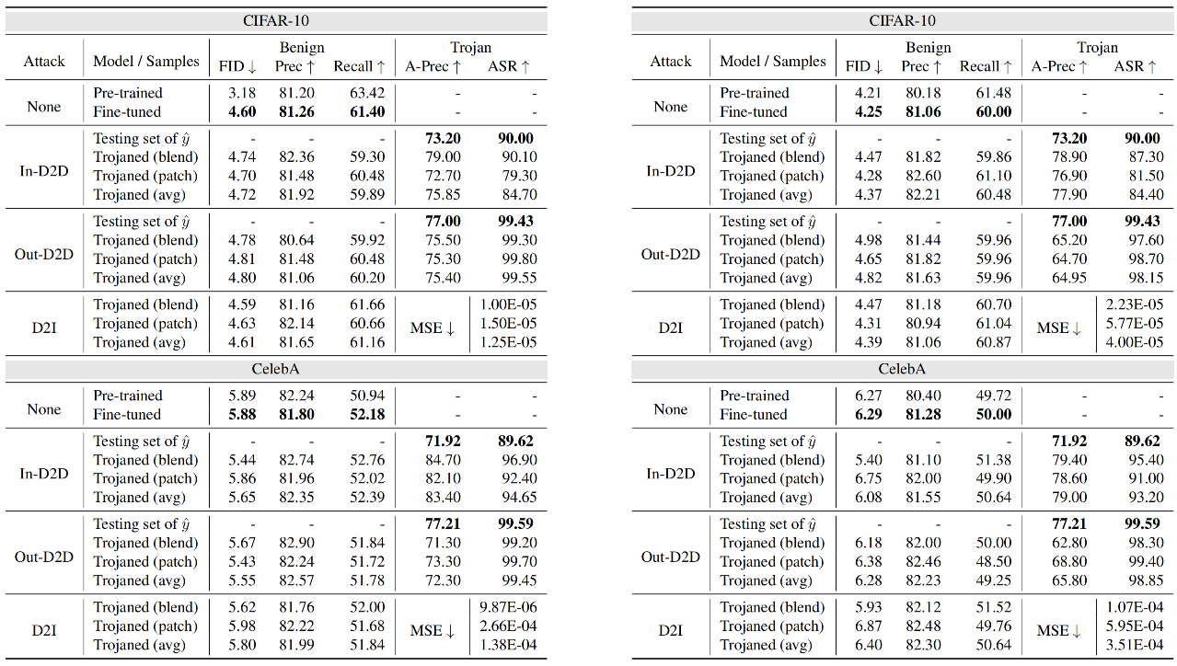
Experiments
TrojDiff always achieves high attack performance under different adversarial targets using different types of triggers, while the performance in benign setting is preserved.
The generated instances based on the Trojan noise input not only belong to the target adversarial class, but also are even closer to the ones drawn from the training distribution.

Slide 10
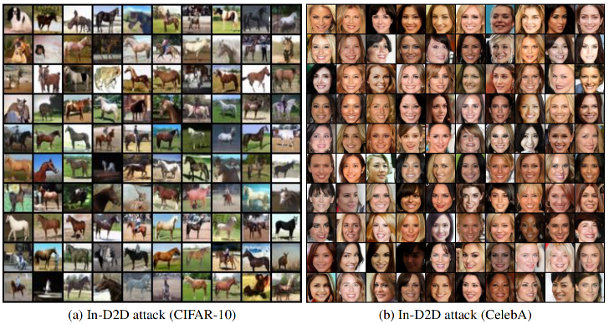
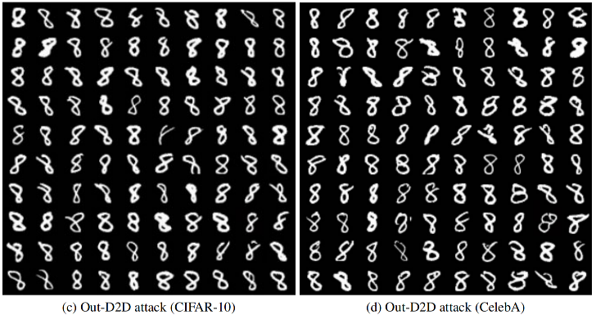
Experiments
Adversarial targets generated by Trojaned models under three types of attacks using blend-based trigger on CIFAR-10 and CelebA datasets

Slide 11
Thank you!
Paper link: https://arxiv.org/pdf/2303.05762.pdf
Code link: https://github.com/chenweixin107/TrojDiff
TUE-AM-385

