Slide 1
Effective Backdoor Defense by Exploiting Sensitivity of Poisoned Samples
Weixin Chen 1, Baoyuan Wu 2, Haoqian Wang 1
1 Tsinghua University
2 The Chinese University of Hong Kong, Shenzhen

Slide 2
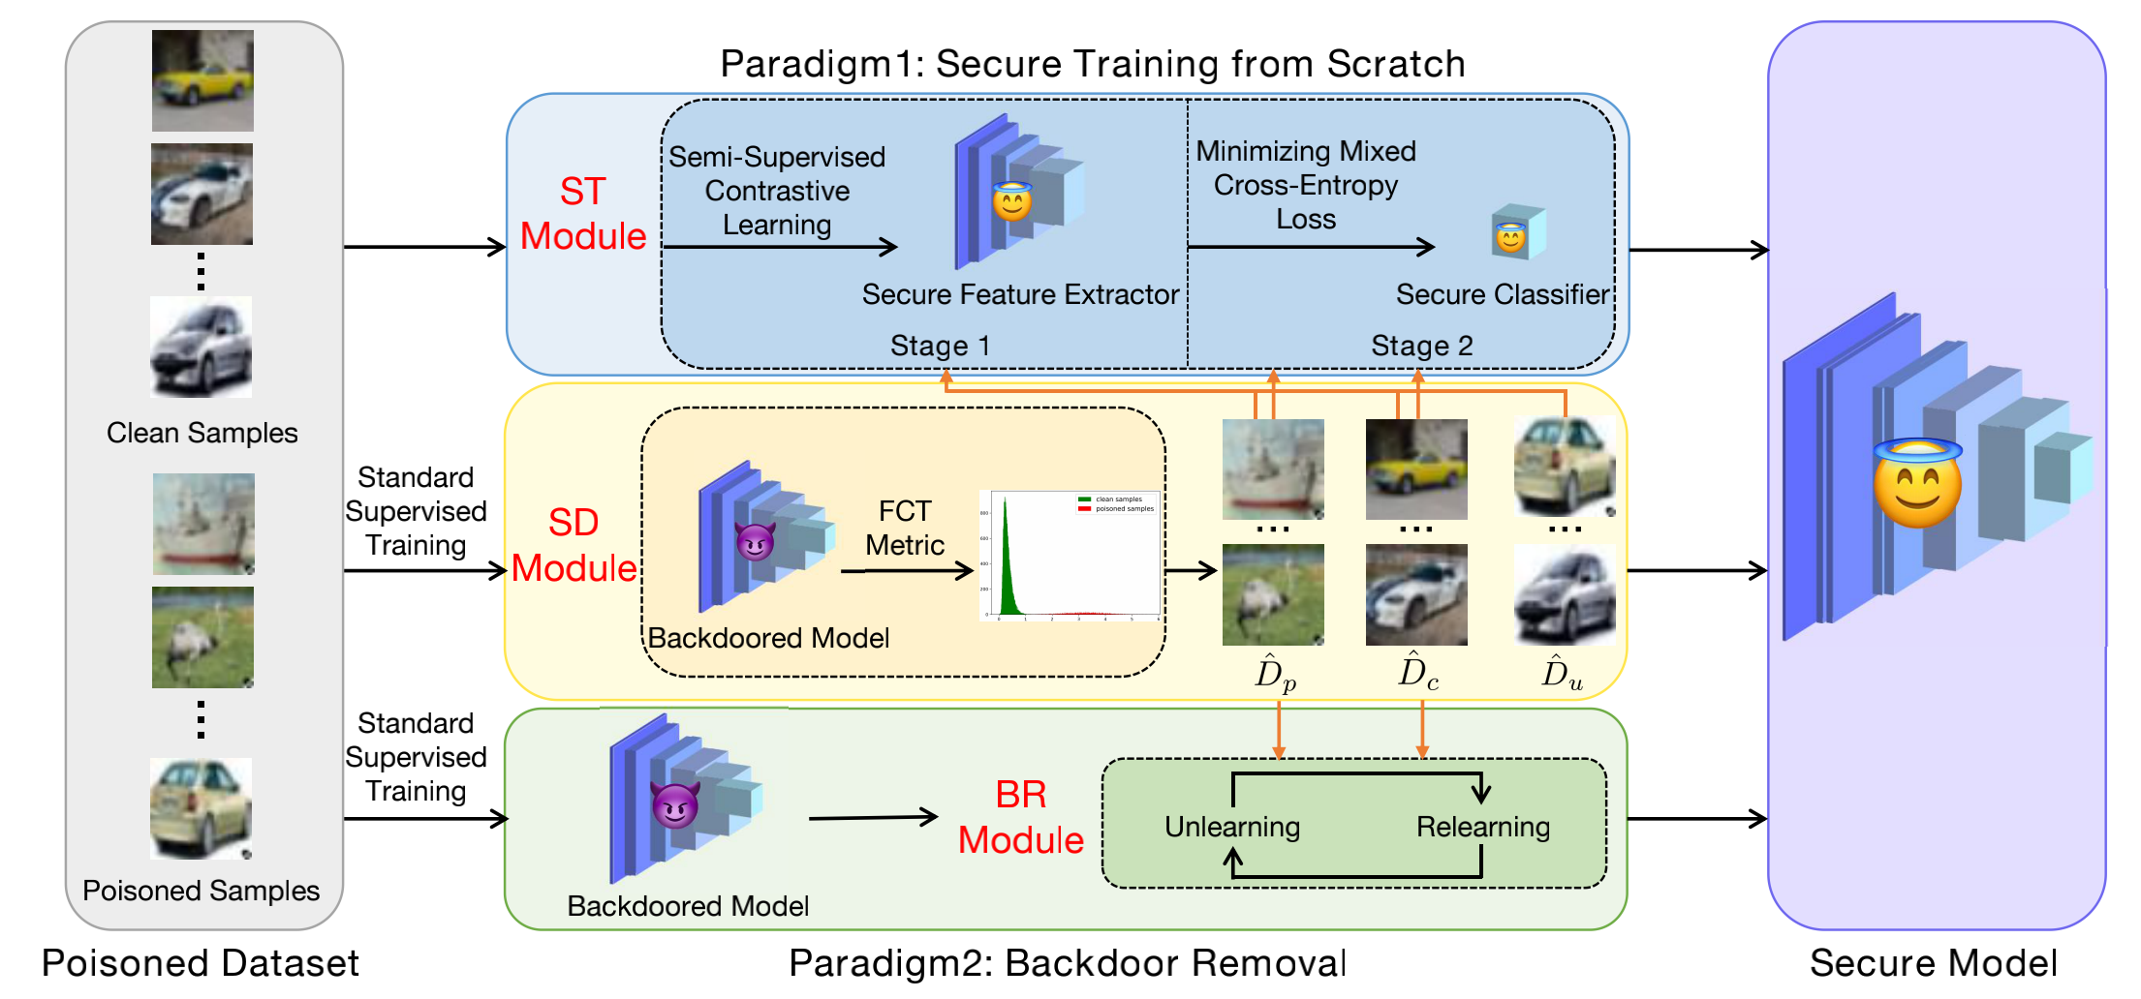
Our work
D-ST
D-BR
Propose two defense methods
D-ST
Paradigm: training a secure model from scratch
Components: SD module + ST module
D-BR
Paradigm: removing backdoor from a backdoored model
Components: SD module + BR module

Slide 3
Outline
This PPT will give a brief introduction for
Sample-Distinguishment (SD) Module
two-stage Secure Training (ST) Module
D-ST Method
Backdoor Removal (BR) Module
D-BR Method

Slide 4
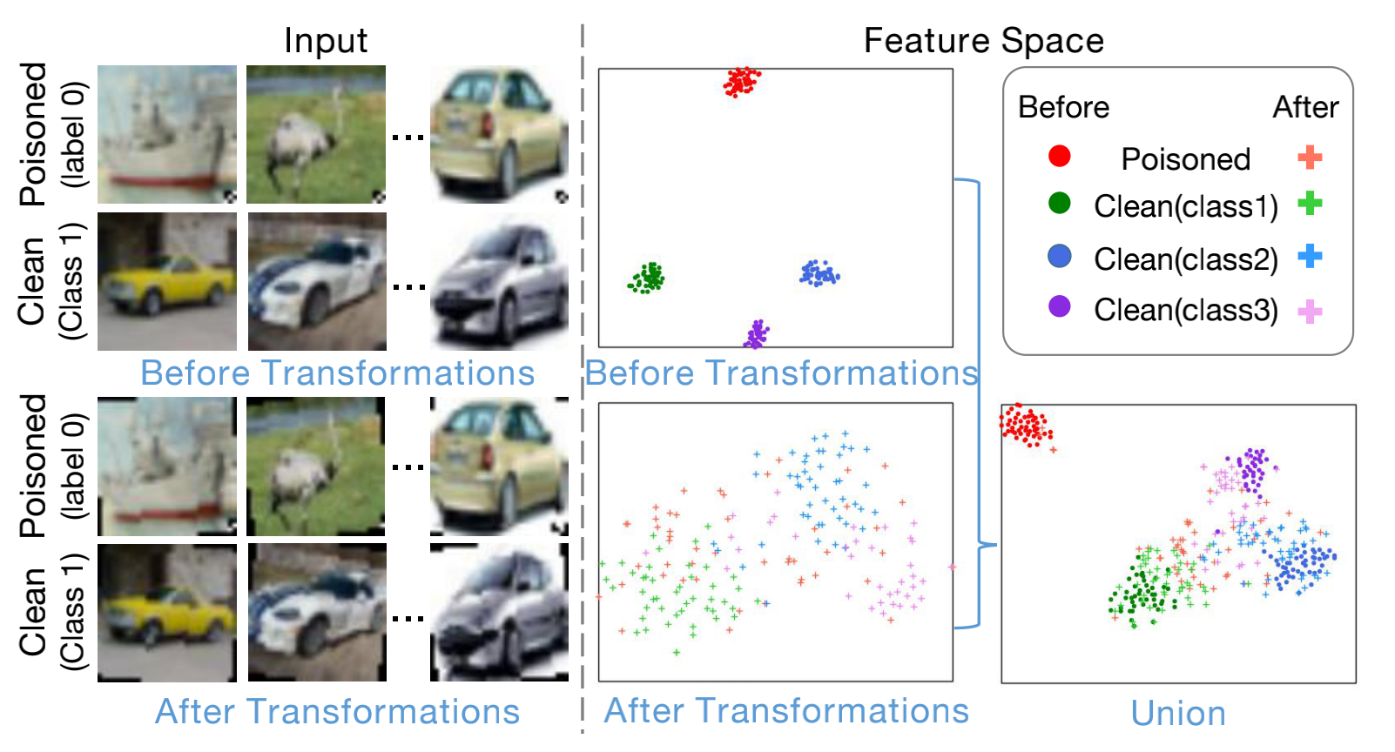
Sample-Distinguishment (SD) Module
What does SD module do?
Distinguish poisoned samples from clean samples in the training set, based on the FCT metric
Motivation
In the feature space of a backdoored model,
(1) Poisoned samples
gather together
(3) Changes of clean samples are much more smaller than those of poisoned samples
[‘Union’ visualizes original samples and perturbed samples in the same space.]
Poisoned samples are more sensitive to transformations than clean samples
(2) Perturbed poisoned samples
no longer gather

Slide 5
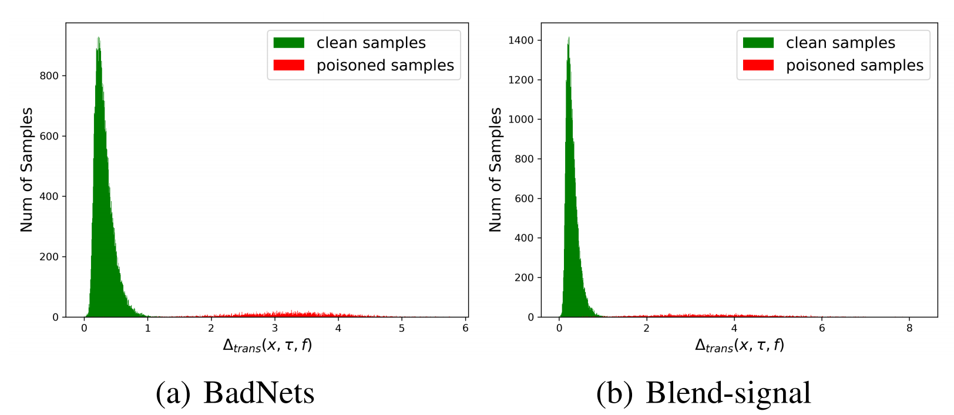
Sample-Distinguishment (SD) Module
Method
Propose a sensitivity metric—Feature Consistency towards Transformations (FCT)—to distinguish samples
, , denote a training sample, a set of transformations and the feature extractor of a backdoored model, respectively
Effectiveness
There is a remarkable difference on the distribution between clean samples and poisoned samples

Slide 6
two-stage Secure Training (ST) Module
What does ST module do?
Train a secure model from scratch
Background
A recent secure-training method DBD
Train a secure feature extractor via contrastive learning (CTL)
Abandon all labels which could waste the valuable information contained in clean samples
Supervised contrastive learning (S-CTL)
Perform better than CTL
Use all labels

Slide 7
two-stage Secure Training (ST) Module
Method
Train a secure feature extractor via semi-supervised contrastive learning
Apply CTL on poisoned samples and uncertain samples
Apply S-CTL on clean samples
Train a secure classifier via minimizing the mixed cross-entropy loss
First item: standard cross-entropy loss defined on clean samples
Second item: negative cross-entropy loss defined on poisoned samples

Slide 8
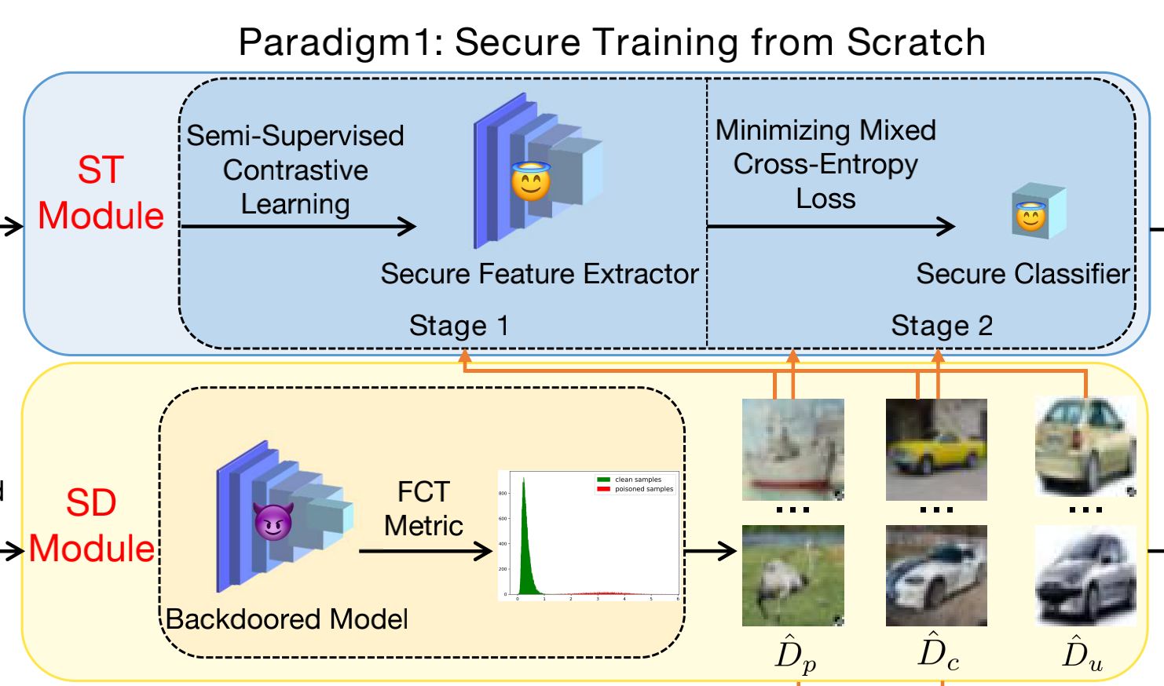
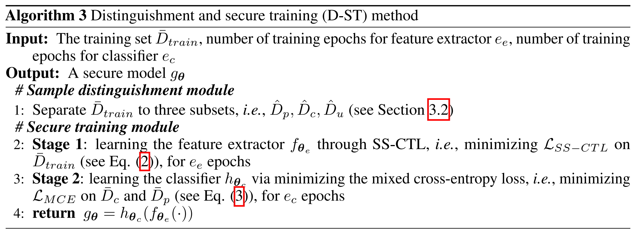
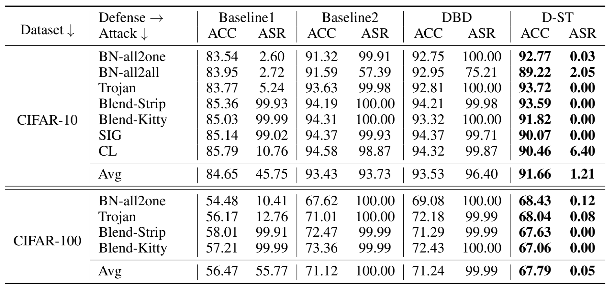
D-ST Method: SD Module + ST Module
Effectiveness

Slide 9
Backdoor Removal (BR) Module
What does BR module do?
Remove backdoor from a backdoored model
Background
Pure unlearning degrades the performance on clean samples
Method
An iterative learning algorithm
Unlearning
Aim to remove backdoor
Relearning
Aim to recover performance on clean samples

Slide 10
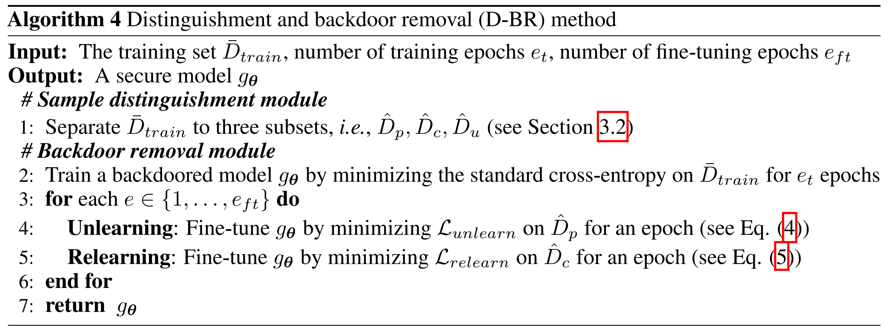
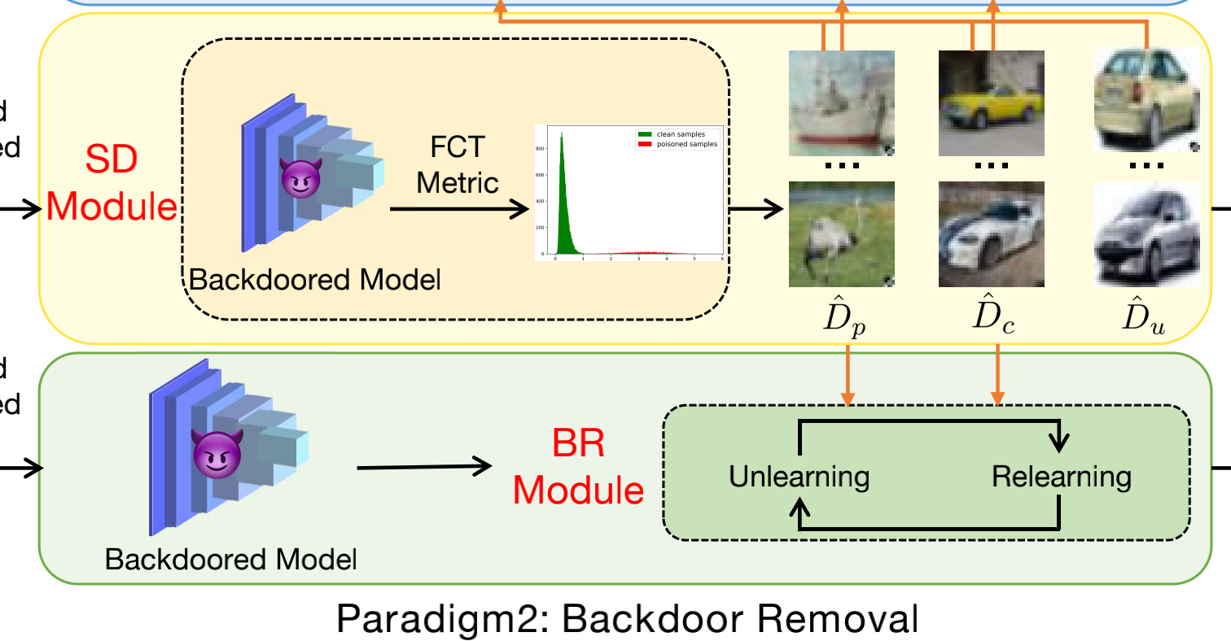
D-BR Method: SD Module + BR Module
Effectiveness

